Slide 1
Modifying
GridWorld Classes

Slide 2
Topics
Structure of GridWorld classes
Creating a GridWorld project without the jar file
Modifying GridWorld classes
Removing grid lines
Changing the color of grid lines
Changing the background color
Using an image as the background
Changing the text on a button
Hiding a button
Closing the world
Changing the thickness of grid lines
Bolding specific grid lines
Zooming in automatically
Making the world window fill the computer screen
Customizing the dimensions of the world window
Using images that are transparent

Slide 3
Structure of
GridWorld Classes
GridWorld source code has been saved to S:\StudentShare\AP Computer Science\GridWorldCode.
The source code is saved in specific folders and subfolders. You should keep them in these same folders underneath your project if you are overriding them. For example, folders info\gridworld\actor corresponds to package info.gridworld.actor in eclipse:
info\gridworld\actor – contains all the Actor classes and images
info\gridworld\grid – contains the Location class and Grid classes, as well as their images
info\gridworld\gui – contains classes related to the gui
info\gridworld\world – contains the World class

Slide 4
Creating GridWorld projects
without a jar file
If you eventually want to create an application or applet based on GridWorld, then you will want to use this approach. This will allow someone to play your game without launching eclipse or some other IDE. To do this you will need to include all the GridWorld source code/compiled code in your project. You should NOT add the external GridWorld jar file to your project. Here is how you can accomplish this:
Create a project in eclipse. Do not add the GridWorld jar file.
Open the GridWorldCode zip file from my website, select all files, and then press Extract. Extract them directly to the project you just created. Note: Do not extract them to a package.
Create another package in this project and this will be where you create your custom classes for your game.

Slide 5
Modifying GridWorld classes
If you don’t need to create an application or applet based on GridWorld, but you want to modify one of its classes, then use this approach. One example is if you want to change the grid lines by either making them disappear or modifying their color. Here is how you can accomplish this:
Create a project in eclipse. Add the external GridWorld jar file to the project as you normally do.
Identify the GridWorld class(es) that you want to modify.
Create a package in your project named just like the package that the class is in (see previous slide). For example, if you want to modify the Actor class, then create a package named info.gridworld.actor.
Copy the class you want to modify from GridWorldCode zip file from my website (see previous slide) and save it into this package. Modify the class as necessary.
Create another package in this project and this will be where you create your custom classes for your game.

Slide 6
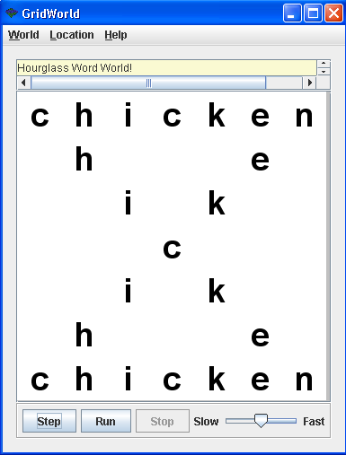
Removing grid lines
To completely remove grid lines:
Make sure you have created the package info.gridworld.gui in your project.
Modify the GridPanel class as follows:
In the paintComponent() method, comment out the line: drawGridlines() .
Save the class.

Slide 7
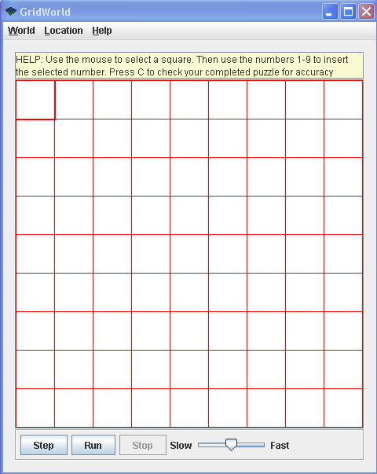
Changing the color
of grid lines
In certain situations, you may want to change the color of grid lines. For example, you may want the background to be red and if you also make the grid lines red, then the grid appears as one red background with no grid lines. Here is how you can do this:
Make sure you have created the package info.gridworld.gui in your project.
Modify the GridPanel class as follows:
In the drawGridlines() method, change the line g2.setColor(Color.BLACK); to g2.setColor(Color.RED);
Save the class.
Notes:
Grid is a row / column structure that stores Objects.
The location of each Object is determined by the Location provided when putting the Object in the grid.

Slide 8
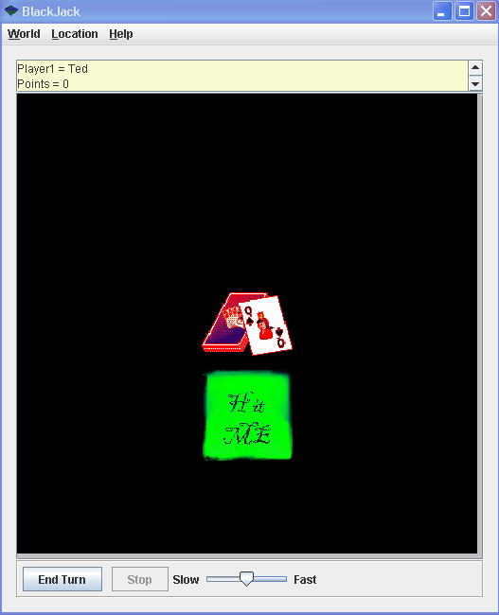
Changing the
background color
In certain situations, you may want to change the background color to something other than white. Here is how you can do this:
Make sure you have created the package info.gridworld.gui in your project.
Modify the GridPanel class as follows:
set the backgroundColor instance variable to Color.BLACK or whatever color you want the background to be.
Save the class.
Notes:
Grid is a row / column structure that stores Objects.
The location of each Object is determined by the Location provided when putting the Object in the grid.

Slide 9
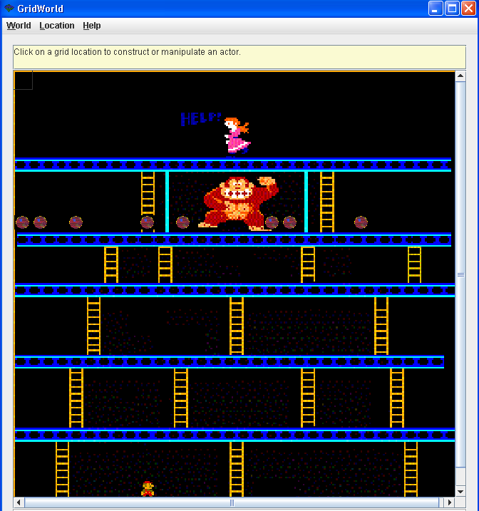
Using an image as
the background
Make sure you have created the package info.gridworld.gui in your project.
Save the image file in the project folder (not the package folder)
Modify the GridPanel class as follows:
In the paintComponent() method insert the following lines of code:
……...
g2.setColor(backgroundColor);
g2.fillRect(insets.left, insets.top, numCols * (cellSize + 1) + 1, numRows
* (cellSize + 1) + 1);
// Begin of code to use an image as the background
BufferedImage img = null;
try {
img = ImageIO.read(new File("starfield.JPG"));
} catch (IOException e) {
}
g2.drawImage(img, insets.left, insets.top, numCols * (cellSize + 1) + 1, numRows
* (cellSize + 1) + 1, 0, 0, img.getWidth(), img.getHeight(), null);
// End of code to use an image as the background
drawWatermark(g2);
………
Notes:
Grid is a row / column structure that stores Objects.
The location of each Object is determined by the Location provided when putting the Object in the grid.

Slide 10
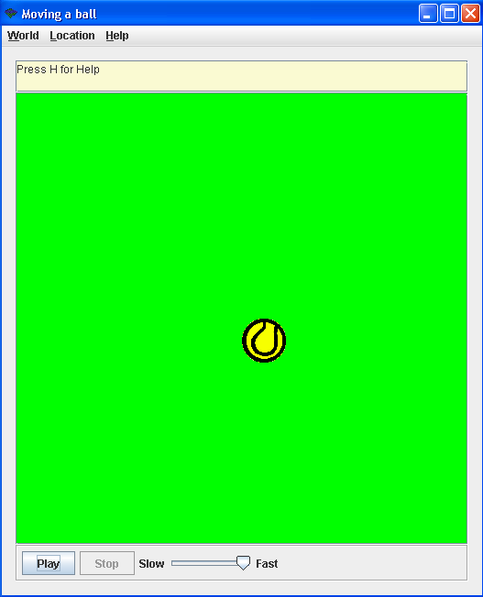
Changing the
text on a button
Make sure you have created the package info.gridworld.gui in your project.
Edit the file named WorldFrameResources.properties. This file contains information about buttons and menus used in GridWorld.
Modify the line for the button you want to change. For example here are the lines that represent the thre buttons for Step, Run, and Stop.
button.gui.step=Step
button.gui.run=Run button.gui.run=Play
button.gui.stop=Stop
slider.gui.slow=Slow
slider.gui.fast=Fast
Notes:
Grid is a row / column structure that stores Objects.
The location of each Object is determined by the Location provided when putting the Object in the grid.

Slide 11
Hiding a button
Make sure you have created the package info.gridworld.gui in your project.
Modify the makeControls() method in the GUIController class. Find the line of code that is adding the button to the panel and comment it out. The following hides the Step button:
Dimension spacer = new Dimension(5, stepButton.getPreferredSize().height + 10);
controlPanel.add(Box.createRigidArea(spacer));
//controlPanel.add(stepButton);
//controlPanel.add(Box.createRigidArea(spacer));
controlPanel.add(runButton);
controlPanel.add(Box.createRigidArea(spacer));
controlPanel.add(stopButton);
runButton.setEnabled(false);
stepButton.setEnabled(false);
stopButton.setEnabled(false);
Notes:
Grid is a row / column structure that stores Objects.
The location of each Object is determined by the Location provided when putting the Object in the grid.

Slide 12
Closing the World
Make sure you have created the packages named info.gridworld.gui and info.gridworld.world in your project.
The frame that the World is based on will need to be closed. The frame is stored in the frame variable in the World class. There is currently no accessor method, so you will need to create one in the World class:
public JFrame getFrame()
{
return frame;
}
Now you can modify your world class (which extends World). In your logic, you will need to close the frame as follows:
getFrame().dispose();
Notes:
Grid is a row / column structure that stores Objects.
The location of each Object is determined by the Location provided when putting the Object in the grid.

Slide 13
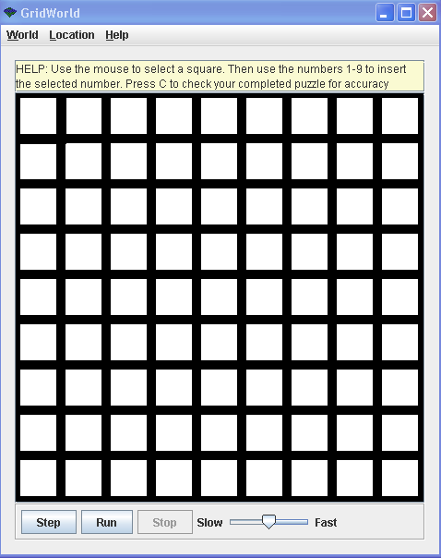
Changing the thickness
of grid lines
Make sure you have created the package named info.gridworld.gui.
You will need to change the stroke that is used before drawing the grid lines. Modify the drawGridLines() method in the GridPanel class.
g2.setStroke(new BasicStroke(10)); //add this
g2.setColor(Color.BLACK);
for (int y = miny; y <= maxy; y += cellSize + 1)
// draw horizontal lines
g2.drawLine(minx, y, maxx, y);
for (int x = minx; x <= maxx; x += cellSize + 1)
// draw vertical lines
g2.drawLine(x, miny, x, maxy);
Notes:
Grid is a row / column structure that stores Objects.
The location of each Object is determined by the Location provided when putting the Object in the grid.

Slide 14
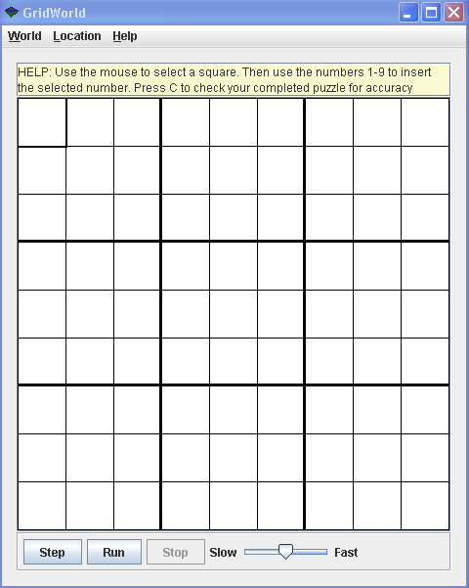
Bolding the grid lines
Make sure you have created the package named info.gridworld.gui.
You will need to add the following code segment after drawing the grid lines at the bottom of the drawGridLines() method in the GridPanel class.
g2.drawLine(146,miny,146,maxy);
g2.drawLine(293,miny,293,maxy);
g2.drawLine(145,miny,145,maxy);
g2.drawLine(292,miny,292,maxy);
g2.drawLine(minx,146,maxx,146);
g2.drawLine(minx,293,maxx,293);
g2.drawLine(minx,145,maxx,145);
g2.drawLine(minx,292,maxx,292);
Notes:
Grid is a row / column structure that stores Objects.
The location of each Object is determined by the Location provided when putting the Object in the grid.

Slide 15
Zooming in automatically
Make sure you have created the package named info.gridworld.gui.
Modify the setGrid() method in the GridPanel class to call the zoomIn() method. This should be done at the bottom of the method after it calculates the cell size:
if (grid.getNumRows() == -1 && grid.getNumCols() == -1)
{
numRows = numCols = 2000;
// This determines the "virtual" size of the pan world
}
else
{
numRows = grid.getNumRows();
numCols = grid.getNumCols();
}
recalculateCellSize(MIN_CELL_SIZE);
this.zoomIn(); // Zoom in at the beginning
Notes:
Grid is a row / column structure that stores Objects.
The location of each Object is determined by the Location provided when putting the Object in the grid.

Slide 16
Making the world
window fill the screen
Make sure you have created the package named info.gridworld.world.
Modify the show() method in the World class as follows. Add the line of code that is highlighted:
public void show()
{
if (frame == null)
{
frame = new WorldFrame<T>(this);
frame.setExtendedState(JFrame.MAXIMIZED_BOTH);
frame.setVisible(true);
}
else
frame.repaint();
}
Notes:
Grid is a row / column structure that stores Objects.
The location of each Object is determined by the Location provided when putting the Object in the grid.

Slide 17
Customizing the dimensions
of the world window
Make sure you have created the packages named info.gridworld.gui and info.gridworld.world in your project.
The frame that the World is based on will need to be modified. The frame is stored in the frame variable in the World class. There is currently no accessor method, so you will need to create one in the World class:
public JFrame getFrame()
{
return frame;
}
Now you can modify your world class (which extends World). In your logic, you will need to customize the frame as follows:
PokerGame game = new PokerGame(new BoundedGrid(6,3));
game.show();
game.getFrame().setSize(345, 750);
Width in pixels
Height in pixels
Notes:
Grid is a row / column structure that stores Objects.
The location of each Object is determined by the Location provided when putting the Object in the grid.

Slide 18
Using images that are
transparent
Make sure that all images you are using are saved in .PNG format
Modify the instance variable named imageExtension in the ImageDisplay class in the info.gridworld.gui package as follows. Change the line to use .PNG extensions (instead of .gif extensions) for images:
private static final String imageExtension = ".png";
Now you need to add transparency to your image:
Launch MS Powerpoint and select Insert > Picture to insert your picture into a slide.
Select the image and select the Picture Tool: Color and scroll to the bottom and pick Select Transparent Color. Using the cursor, click on the white area in the background of your picture. This will make all white areas transparent.
Right click on the picture and select Fill > Picture or text fill and move the Transparency slider bar to 100%.
Right click on picture and select Save as picture and save to your workspace as a PNG file.
Notes:
Grid is a row / column structure that stores Objects.
The location of each Object is determined by the Location provided when putting the Object in the grid.

